Slide 1
Smart Irrigation System for Precision Farming
CSE7101- Capstone Project
Review-1
Batch Number:
CSE_159
Roll Number | Student Name
20221CSE0120 | Polisetty Vamsi Bala Kiran
20221CSE0112 | Muvvala Siva Kumar
20221CSE0115 | Narala Pallavi
Under the Supervision of,
Dr.Venkataravana Nayak K
Assistant Professor
School of Computer Science and Engineering,
Presidency University.
Name of the Program: B-Tech(C.S.E)
Name of the HoD: Dr. Asif Mohammed , Dr. Blessed Prince
Name of the Program Project Coordinator: Dr. Jayavadivel Ravi, Mr.Muthuraju V
Name of the School Project Coordinators: Dr. Sampath A K , Dr. Geetha A

Slide 2
Problem Statement Number: PSCS_208
Organization: Presidency University
Category : Hardware and Software
Problem Description:
Traditional irrigation methods waste water and increase costs due to fixed schedules and manual operation. They fail to adapt to real-time soil and environmental conditions, leading to reduced crop yield. The proposed Smart Irrigation System uses IoT sensors, an ESP8266 microcontroller, and the Blynk platform to automate irrigation, optimize water usage, and improve farming efficiency.

Slide 3
Problem Statement:
Current irrigation practices in agriculture often lead to water wastage and inefficiency due to the lack of real-time monitoring and automated control. There is a need for a smart, cost-effective system that can monitor soil and environmental conditions, automate irrigation, and optimize water usage for improved crop productivity.
Objectives:
Monitor soil moisture, temperature, and humidity in real time.
Automate irrigation using IoT-enabled sensors and ESP8266.
Enable remote monitoring and control through the Blynk platform.
Reduce water wastage and improve crop productivity.

Slide 4
Background & Related Work:
IoT-based smart farming solutions improve irrigation efficiency through sensor data and automation.
Prior research shows integrating soil moisture, temperature, and humidity sensors with wireless communication reduces water usage and improves yield.
Existing systems often lack scalability, real-time alerts, and adaptive control.
Innovation / Novel Contributions:
Integration of ESP8266 with Blynk IoT for real-time monitoring and control.
Dual operation modes: Automated and Manual override.
Cost-effective, scalable design suitable for small and large farms.
Real-time environmental data processing for optimized irrigation schedules.

Slide 5
Analysis of Problem Statement
Water Wastage in Agriculture:
Traditional irrigation often applies more water than needed, leading to wastage and depletion of water resources.
Manual Operation Challenges: Farmers must manually operate pumps and monitor soil, which is time-consuming and labor-intensive.
Lack of Real-Time Monitoring: Most existing systems cannot adapt to changing soil moisture, temperature, or humidity conditions instantly.
Impact on Crop Yield: Over-irrigation and under-irrigation both harm crop health, reducing productivity and profitability.
Need for Affordable Smart Solutions: Many advanced irrigation systems are costly and inaccessible to small and medium-scale farmers.
Proposed Approach: Implement an IoT-enabled, cost-effective system that uses ESP8266, soil moisture sensors, and the Blynk IoT platform to provide automated irrigation with remote control and monitoring capabilities.

Slide 6
Analysis of Problem Statement (contd...)
Technology Stack Components:
Hardware:
ESP8266 Wi-Fi Module
Soil Moisture Sensor
DHT11/DHT22 Sensor
Relay Module & Water Pump
Power Supply
Software:
Arduino IDE (ESP8266 Programming)
Blynk IoT Platform

Slide 7
GitHub Link
GitHub Link
https://github.com/pallavi-1609/Smart-Irrigation-System-for-Precision-Farming

Slide 8
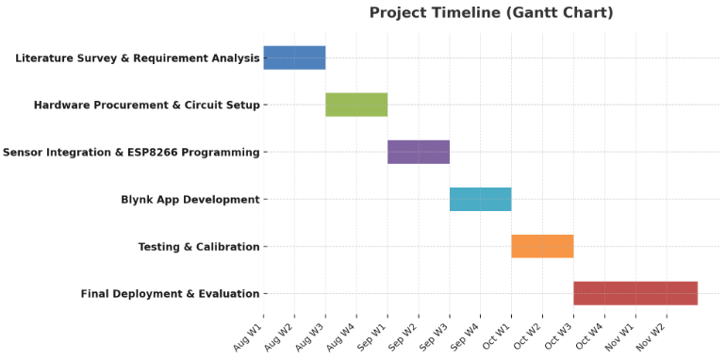
Timeline of the Project (Gantt Chart)

Slide 9
References (IEEE Paper format)
[1] A. Kumar, B. R. Patel, and C. Zhang, “Plant disease identification using convolutional neural networks,” IEEE Access, vol. 9, pp. 34567–34578, Mar. 2021.
[2] J. Smith, “Deep learning in agricultural systems,” IEEE Transactions on Neural Networks and Learning Systems, vol. 32, no. 7, pp. 1234–1245, Jul. 2021.
[3] M. A. Hannan, M. J. Islam, M. Basri, H. Y. Choi, M. M. Rashid, and A. Hussain, “A smart irrigation system for precision agriculture using wireless sensor networks,” IEEE Internet of Things Journal, vol. 6, no. 2, pp. 2071–2081, Apr. 2019.
[4] A. S. El-Wakeel, M. A. Ramadan, and E. A. Mohamed, “IoT-based monitoring and control system for precision agriculture,” IEEE Access, vol. 8, pp. 125369–125379, Jul. 2020.

Slide 10


